Slide 1
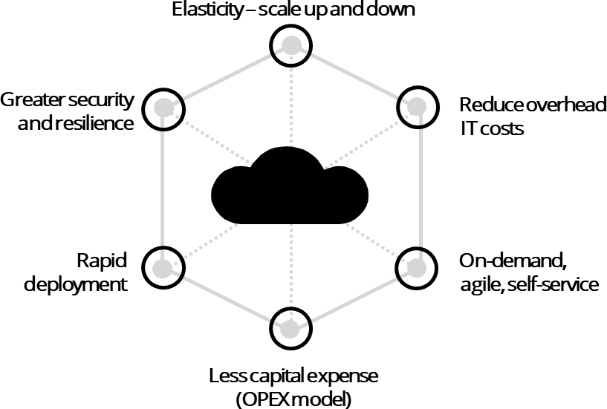
A Glance at Cloud – What is Cloud Computing?
Cloud Computing is an alternative model for running IT workloads by leveraging the hosting infrastructure of an external provider
Defining Cloud Computing
Cloud can be defined as on-demand delivery of IT resources and applications via the Internet with pay-as-you-go pricing. The transition to cloud will:
Enable the ability to scale up and down allowing an elastic infrastructure;
Reduce or eliminate the purchase and maintenance of hardware; shifting
focus to core competencies;
Be centrally managed as the service is operated and hosted by the provider i.e. AWS, Azure; and
Provide the ability for business to only pay for what services are used.
Cloud Capabilities
Cloud has a variety of different use cases and capabilities in Higher Education. A few examples of what Universities could do with Cloud are listed below:
Cloud Characteristics
Businesses have the option of three cloud platforms including Public, Hybrid or Private Cloud based on their needs. In all cases, data can be as or more secure than it is with on-premise options.
Integrating cloud technologies can help companies optimise their capabilities,
improve efficiencies, reduce risk, break down internal silos, and innovate faster.
Highlighted below are some of the key characteristics of Cloud:
Self-provisioning Cloud compute for researchers to enable on-demand compute;
Developing and scaling a MOOC (massive online open course) through
Cloud infrastructure;
Streaming lecture recordings through Cloud services to reduce latency and keep up with peak demand;
Using remote desktop services to replace specialised computer labs with specialised software (e.g. graphical and video processing software); and
Complete decommissioning of existing Data Centre facilities and hardware.

